Slide 1
Human Resource Management
ABC Technologies Company
Staffing plan for the new MRO (Maintenance & Repair Operations)
Presented By:
University Name:

Slide 2
Background Information: ABC Technologies
ABC Technologies is a company that is Stablished to manufacture farming equipments that are sold globally to consumers.
ABC Technologies has recently modified it's strategic plan to add the On-Site service call division
The On-Site service call division will provide MRO (Maintenance & Repair Operations) for the equipments sold by ABC Technologies.
ABC Technologies seeks to gain profits from servicing all of the engines sold to client just like GE.

Slide 3
Staffing Goals and objectives for the new MRO Division
The HR seeks to Recruit and Select the new workforce at MRO division
The HR at ABC Technologies to reach the goal of 90% employee retention after one year.

Slide 4
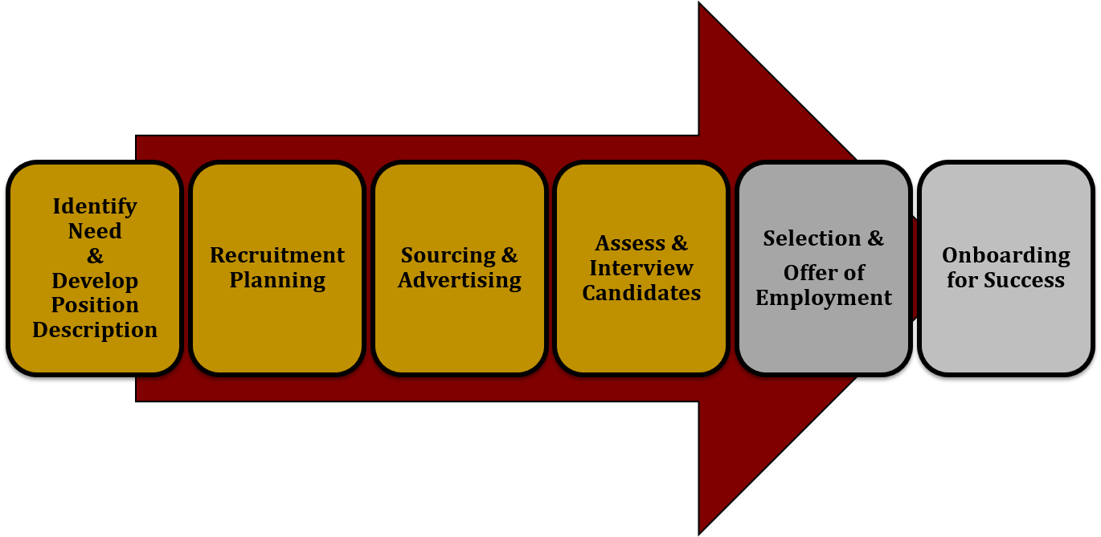
HR Recruitment & Selection
Recruitment refers to the process where potential applicants are searched for, and then encouraged to apply for an actual or anticipated vacancy.
Selection is the process of hiring employees among the shortlisted candidates and providing them a job in the organization.

Slide 9
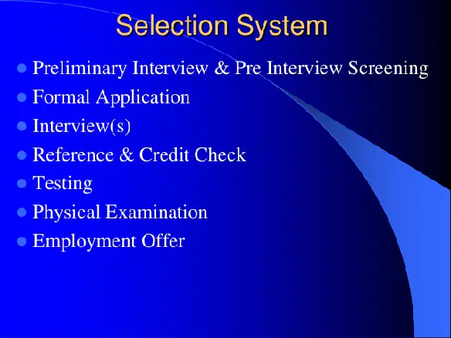

Slide 11
Initiatives HR will engageti reach the goal of 90% Employee retention
The employee retention strategies for increasing job satisfaction
Onboarding and orientation — Every new hire should be set up for success from the start.
Mentorship programs — Pairing a new employee with a mentor is a great component to add to your extended onboarding process, especially in a remote work environment.

Slide 13
References:
Armstrong, M. (2006). A handbook of human resource management practice, London: Kogan Publishers.
Aswathappa, K. (2005). Human resource and personnel management. Chicago: Tata McGraw-Hill.
Cantano, V.M. (2009). Recruitment and selection in Canada. New York: Cengage Learning.
Erasmus, B. & Swanepoel, B. & Schenk, H. (2009). South African human resource management: theory and practice. New York: Juta and Company Ltd.
Evers, A., Anderson, N. & Voskuijl, O. (2005). The Blackwell handbook of personnel selection. New York: Wiley-Blackwell.
Dale, M. (2003). Managers guide to recruitment and selection. London: Kogan Page Publishers.
Dessler, G. (2005). Human resource management. New Jersey: Pearson Prentice.
Hitt, M., Ireland, D. & Hoskisson, R. (2009). Strategic management: competitiveness and globalization: concepts and cases. New York: Cengage Learning.

